Slide 1
New Realities for Accreditors and Postsecondary Systems
Sally Johnstone (NCHEMS) & Barbara Brittingham (NECHE)
Leah Matthews, President, Distance Education Accrediting Commission
James Page, former Chancellor of the University of Maine System
Sonny Ramaswarmy, President, Northwest Commission on Colleges and Universities
Joseph Vibert, Executive Director, Association of Specialized and Professional Accreditors
Karen Whitney, former Chancellor, Pennsylvania State System for Higher Education
Richard Winn, President, Accrediting Commission for Community and Junior Colleges

Slide 2
Agenda
Introductions
Brief shifting demographics reminder
State examples – ME, PA, AK, CA
Emerging adaptations
Reflections
Small group discussion of strategies
Report out of action steps

Slide 3
Introductions Who are you? What is your affiliation and role?

Slide 4
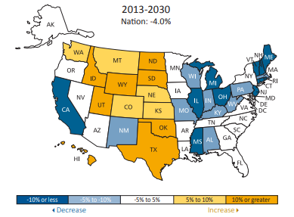
Shifting Demographics
Source: Peace Bransberger & Demarée K. Michelau. Knocking at the College Door: Projections of High School Graduates, 9th Edition, Boulder, CO: Western Interstate Commission for Higher Education, 2016.

Slide 5
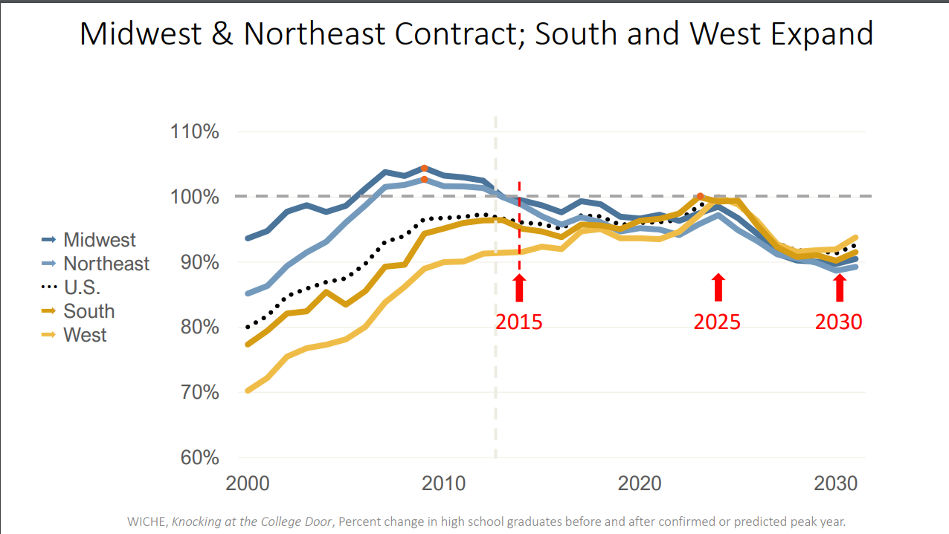

Slide 7
Standard & Poor’s analysis of higher education, January 2020 “Our outlook for the sector remains negative for the third consecutive year, given the sector's challenging operating environment and our expectation that negative rating actions will outpace positive rating actions again this year.”

Slide 8
Examples of challenges
ME – Jim Page, former Chancellor University of Maine System
PA – Karen Whitney, former Chancellor, PA State System of Higher Education
AK – Sonny Ramaswamy, President, Northwest Commission on Colleges and Universities
CA – Richard Winn, President, Accrediting Commission for Community and Junior Colleges & Sally Johnstone, NCHEMS

Slide 9
Emerging adaptation
Barbara Brittingham, New England Commission of Higher Education
Leah Matthews, Distance Education Accrediting Commission & Richard Winn, Accrediting Commission for Community and Junior Colleges

Slide 10
Reflections
Joseph Vibert, Association of Specialized and Professional Accreditors
Jim Page, University of Maine System
Diane Auer Jones, Principle Deputy Undersecretary, U.S. Department of Education

Slide 11
Small Group Discussions
What are next steps toward a more productive relationship between accreditors and state higher ed systems?
What are the barriers to those relationships and how can we eliminate/reduce them?
Are there other players (and who are they) who can contribute to improving the current rather chaotic environment?

Slide 12
Action Items & Volunteers

