Slide 1
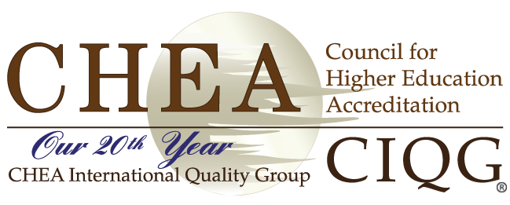
Combatting Academic Corruption:
What Might the International Quality Assurance Community Do?
WEBINAR
December 12, 2016

Slide 2
Advisory Statement

Slide 3
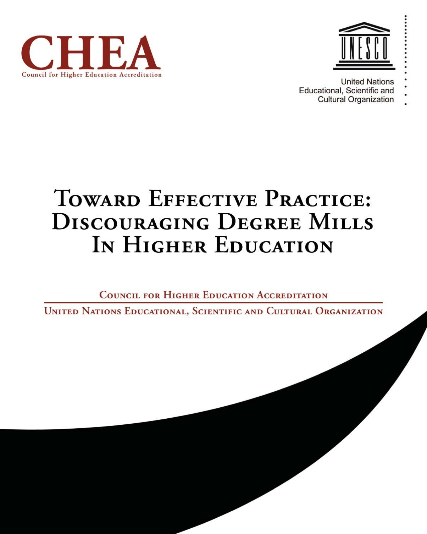
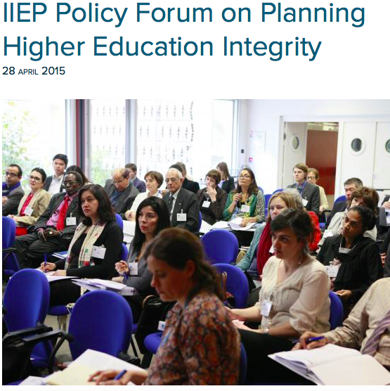
BACKGROUND
2009
2015

Slide 4
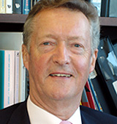
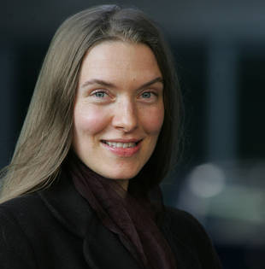
Panelists
Sir John Daniel,
Contact North|Contact Nord
Manja Klemenčič
Lecturer
Harvard University

Slide 5
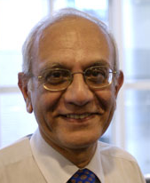
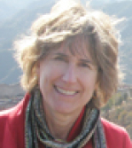
Panelists
Goolam Mohamedbai
Former Secretary-General of Association of African Universities
Mary Beth Marklein
Reporter
University World News

Slide 6
QUESTIONS
In what areas of corruption might the international quality assurance community take a prominent role?
What kinds of actions might the community take?
How do we galvanize our quality assurance colleagues to provide leadership to combat corruption?

Slide 7
QUESTIONS
As the international quality assurance community moves forward, who are our natural allies and stakeholders and how do we reach out to them?
How might responses to these questions provide a foundation for the development of an action plan?

Slide 8
Panelists
Sir John Daniel
Contact North|Contact Nord
Manja Klemenčič
Lecturer
Harvard University

Slide 9
Q & A
and focus on action steps
Combatting Academic Corruption:
What Might the International Quality Assurance Do?

Slide 10
Panelists
Goolam Mohamedbai
Former Secretary-General of Association of African Association
Mary Beth Marklein
Reporter
University World News

Slide 11
Q & A
and focus on action steps
Combatting Academic Corruption:
What Might the International Quality Assurance Do?

Slide 12
Combatting Academic Corruption:
What Might the International Quality Assurance Community Do?
WEBINAR WRAP-UP
December 12, 2016

