Slide 1
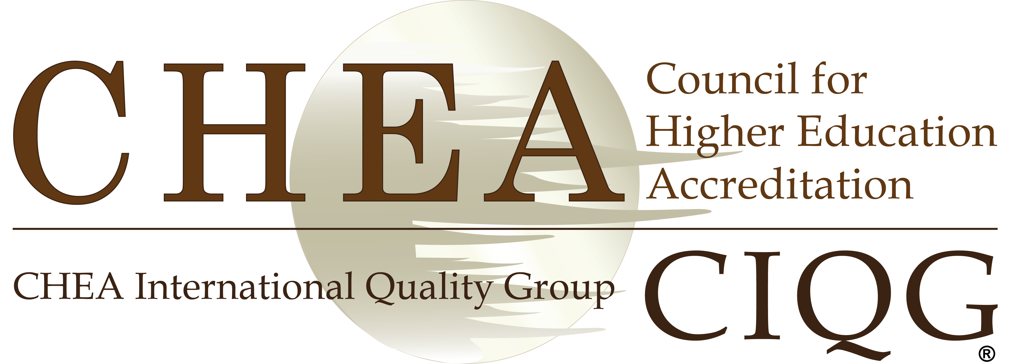
CHEA International Quality Group (CIQG)
Webinar Series #2
Combatting
Academic Corruption:
Focus on Quality Assurance and Plagiarism
Monday 10 July 2017
Our panel of experts:
Jamil Salmi
Professor N.V. Varghese
Carolyn Campbell
Global Tertiary Expert
Morocco
Director of the Centre for Policy Research in Higher Education (CPRHE)
New Delhi
Senior Consultant
The Observatory on Borderless Education
United Kingdom

Slide 2
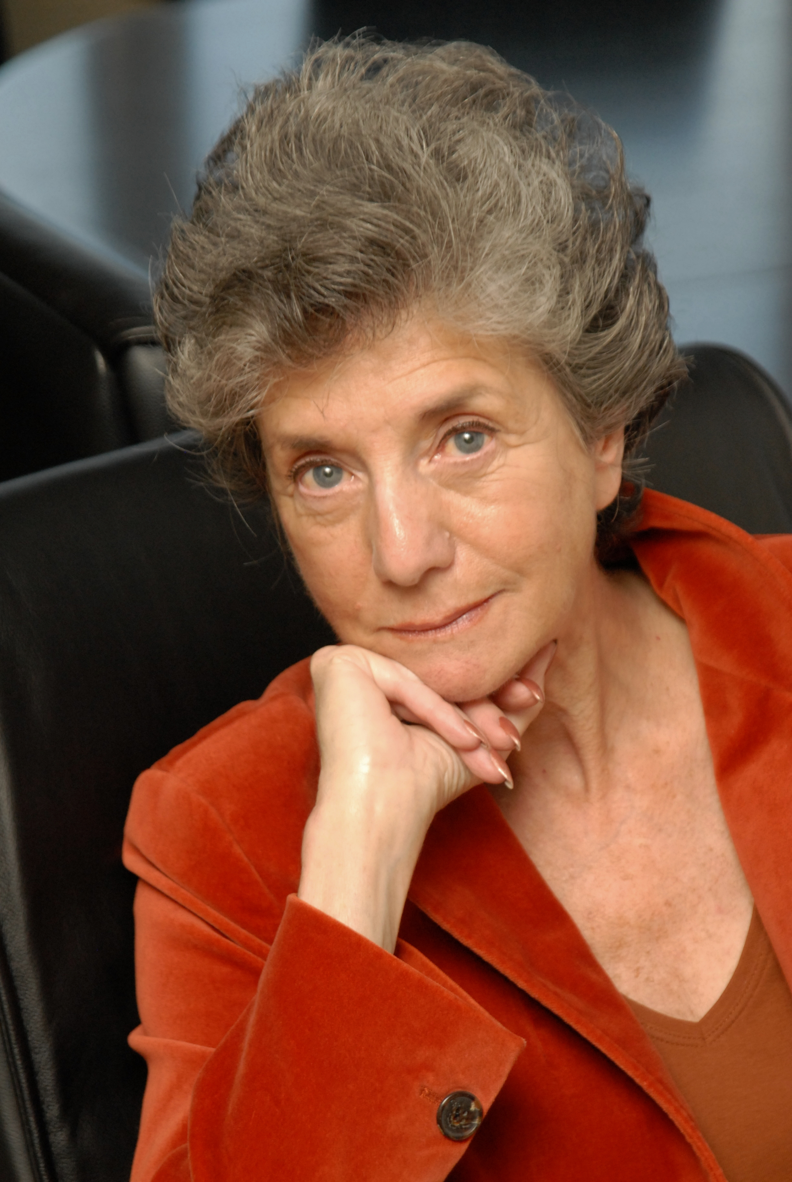
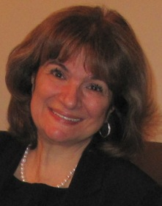
Dr. Judith S. Eaton President Council for Higher Education Accreditation
Stamenka Uvalić-Trumbić
CHEA Senior Advisor on International Affairs
Brian “Blu” Christopher Kelley
Director of CHEA International Quality Group (CIQG)

Slide 3
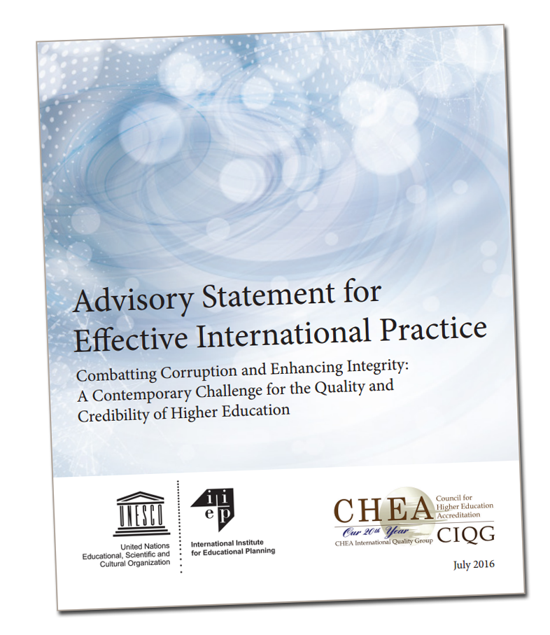

Slide 4
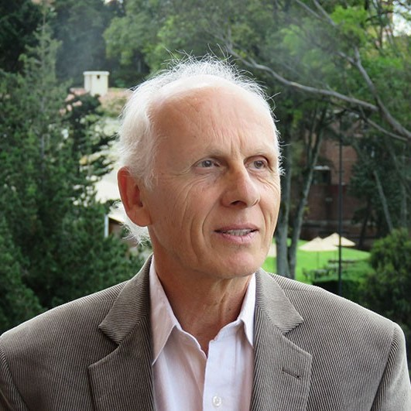
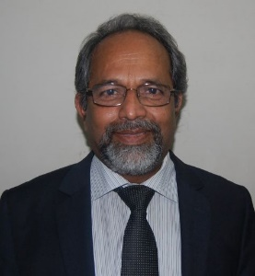
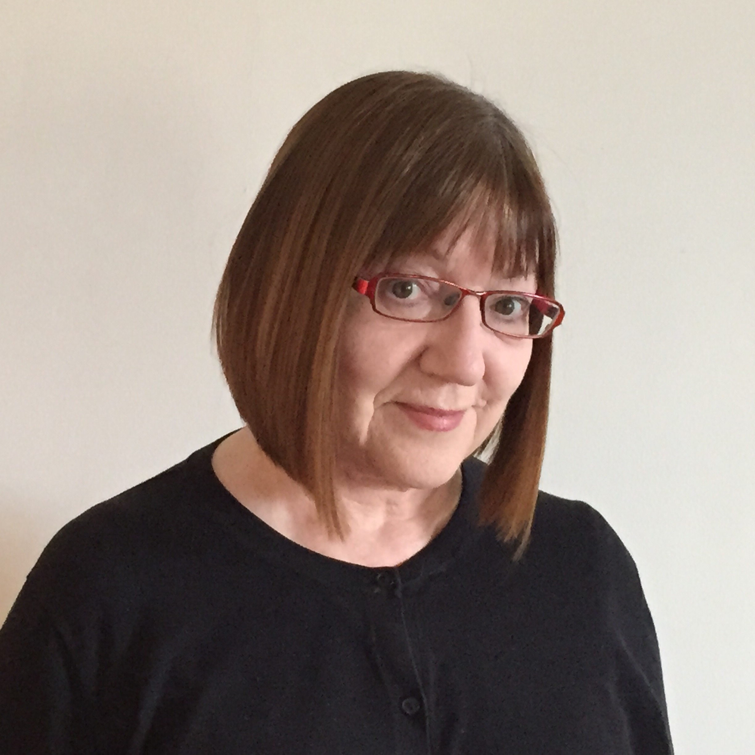
Jamil Salmi
Global Tertiary Expert
Morocco
Professor N.V. Varghese
Director of the Centre for Policy Research in Higher Education (CPRHE) New Delhi
Carolyn Campbell
Senior Consultant
The Observatory on Borderless Education
United Kingdom

Slide 5
Thank you for joining us!
Jamil Salmi | jsalmi@tertiaryeducation.org
N.V. Varghese | nv.varghese@nuepa.org
Carolyn Campbell | carolyn.campbell@obhe.org
www.chea.org
One Dupont Circle NW, Suite 510 ⦁ Washington, DC 20036-1135 ⦁ Tel: 202-955-6126

